Slide 1
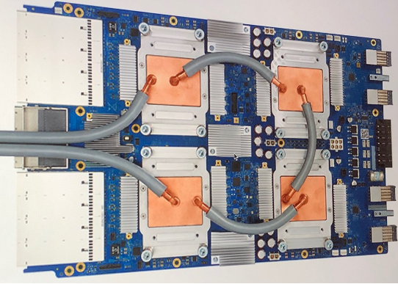
Flower classification using deep learning methods on TPU
Mudiha wazirali
Mentor: Dr. Mhoon
University of Houston - Downtown

Slide 2

Motivation
Interest in improving understanding and skills of deep learning methods on the cloud
Improving the ability to adapt to different Python libraries and utilize them accurately and efficiently
Developing confidence and quickness in skills implementation by taking part in Kaggle competitions
Inspired by the Kaggle competition: https://www.kaggle.com/c/flower-classification-with-tpus
Objective: To build an efficient and cost-effective machine learning model using TPUs that identifies the 104 types of flowers in a dataset of images.

Slide 3
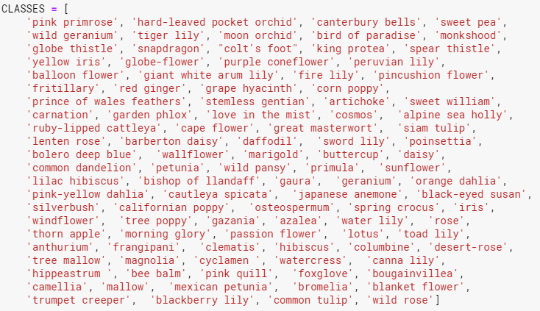
Data Exploration
Over 400,000 Types of Flowers in the wild
Dataset includes 104 Types of Flowers
Each sample is a TFRecord
A container format
Used in Tensorflow to group and share data files for optimal training performace
Each file contains:
Id
Label: class of each element in training data
img : pixels in array form

Slide 4
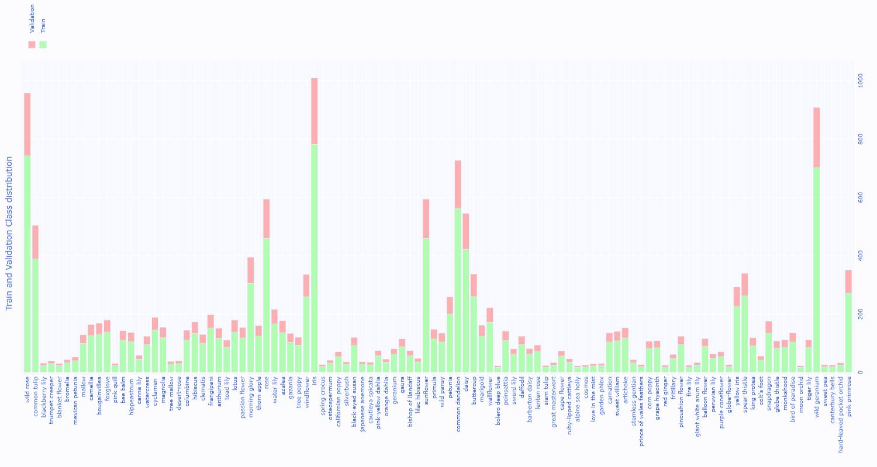

Train and validation distribution and Class Imbalance

Slide 5
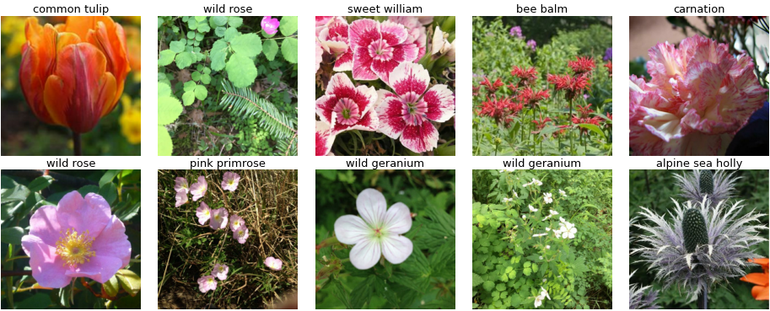
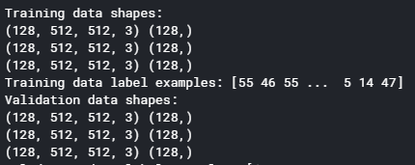
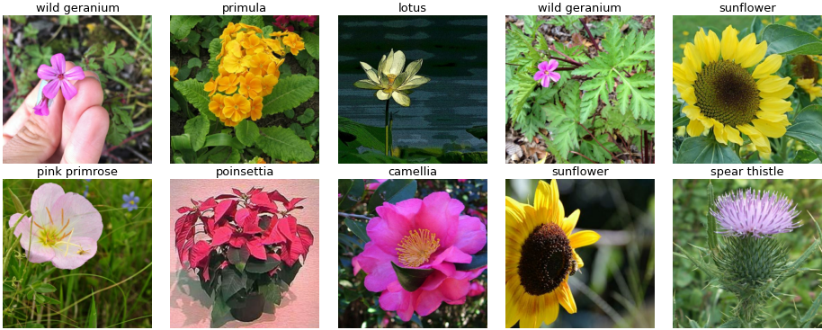
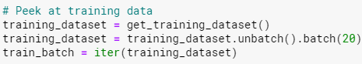
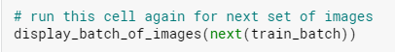
Image Shapes and labels

Slide 6
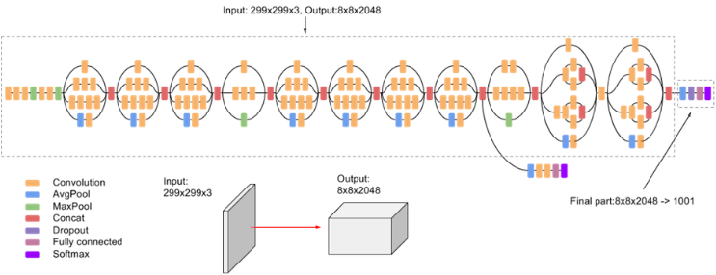
Inception_V3 Architecture: a convolutional neural network that has 159 Layers

Slide 7
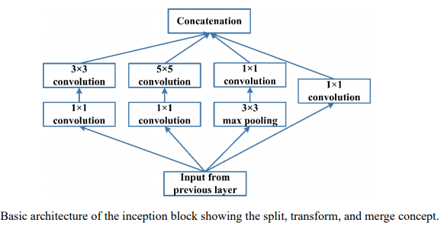
Inception block
https://arxiv.org/ftp/arxiv/papers/1901/1901.06032.pdf

Slide 8
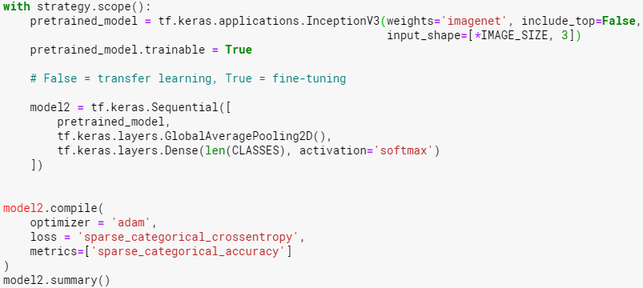
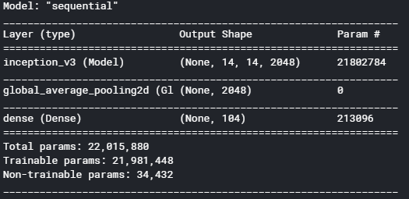
Inception_V3 Model

Slide 9


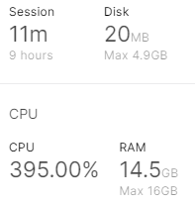
Inception_V3 : Run on CPU w/ TPU OFF
Time consuming
Possibility of crashing high

Slide 10
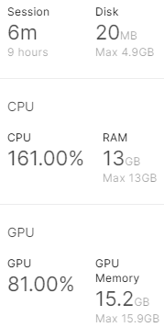
Inception_V3 : Run on GPU w/ TPU OFF
Possibility of crashing high due to not having enough memory allocated

Slide 11
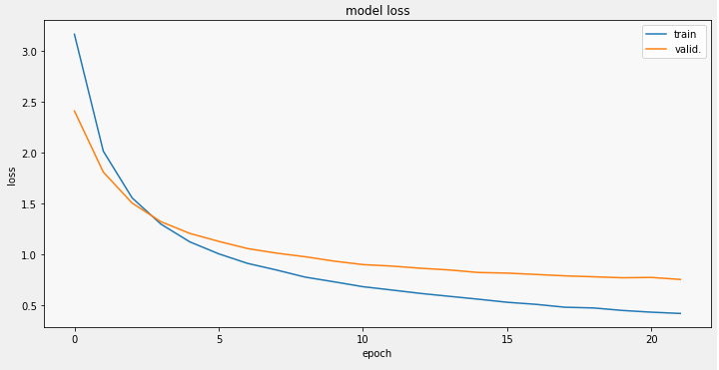

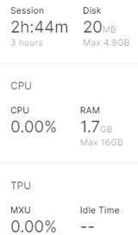
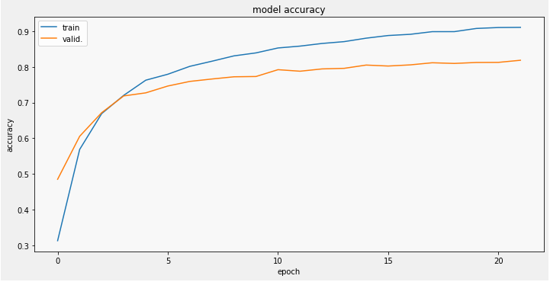
Inception_V3 : Run on CPU w/ TPU on but not utilized
Still time consuming
12% of the steps per epoch compared to only CPU or GPU runs
1.5% of total steps for whole model compared to only CPU or GPU runs
Inefficient
Crashing is not an issue due to large memory availability

Slide 12
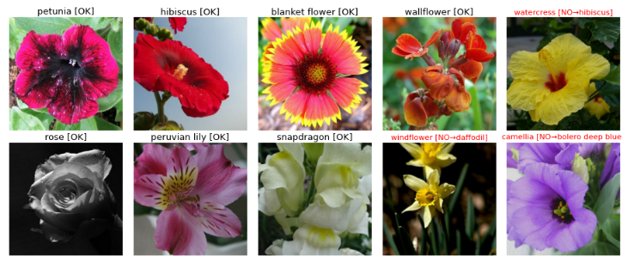
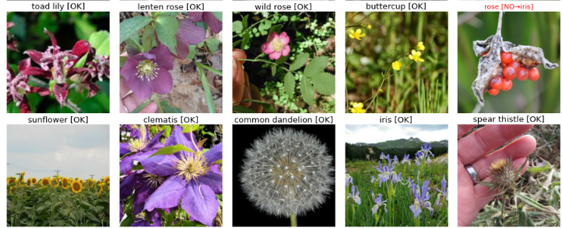
Inception_V3 : Run on CPU w/ TPU on but not utilized model predictions
Prone to mislabeling

Slide 13
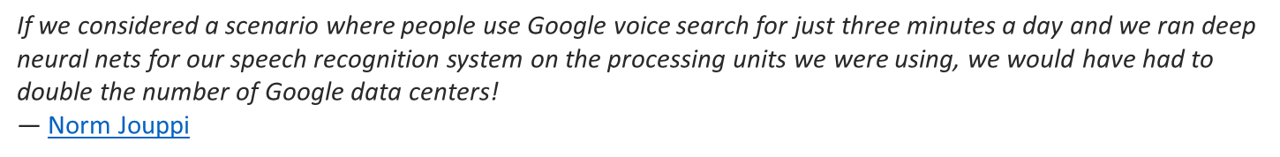
Need for a cost-effective design of a custom chip
Application-specific integrated circuit (ASIC)
Cons:
Takes a long time to design
Google developed the TPUv1 faster than normal in 15 months
Initially expensive: specialized engineers and manufacturing costs at about 1 million
Inflexible: no way to change the chip once completed
Pros:
Does one particular job in enough volume
Generally the fastest and most energy-efficient way to accomplish a task
Recurring benefits may make up for the initial drawbacks
Google wanted that long term performance to run neural networks → TPU is the result.

Slide 14
Benefits of using tensor processing units (tpu)
CPU : general purpose computational processor
GPU : accelerate rendering of graphics
TPU : accelerate deep learning tasks
Multiplying and taking slices from arrays takes a lot of CPU clock cycles and memory
TPUs were designed to relieve these specific workloads.
First generation of TPUs: have targeted inference
Used an already trained model
Later versions allow adjustments to layers within the model during the training phase
TPU is 15 times to 30 times faster than contemporary GPUs and CPUs

Slide 15
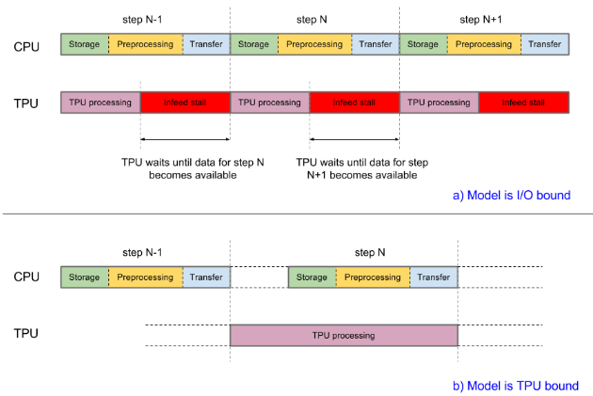
TPU Efficiency depends on models

Slide 16

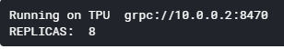
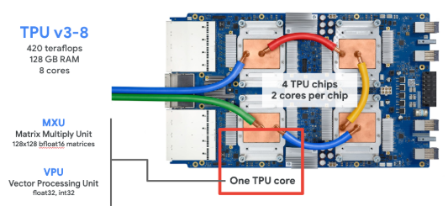
TPU Structure
Each TPU core has:
A traditional vector processing part (VPU)
Dedicated matrix multiplication hardware capable of processing 128x128 matrices which accelerates machine learning workloads
128GB of high-speed memory
512 x 512 pix input images will be utilized for model
Allows larger batches, models, and training inputs
Larger batches result in faster modeling: i.e. 128 * 8 = 1024

Slide 17
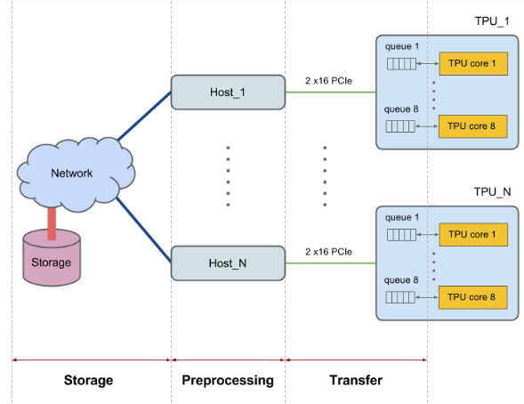
Input pipeline

Slide 18
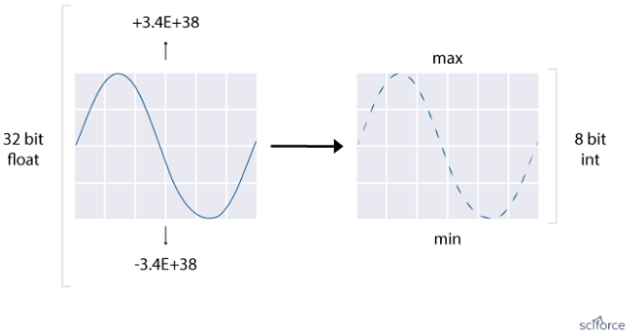
The math behind TPU
Quantization: Compression of floating point calculations with 32-bit or 16-bit numbers → 8-bit integers
Reduces the cost of neural network predictions without significant losses in accuracy
Focus on inference maths:
Matrix Multiplier Unit (MXU): 65,536 8-bit multiply-and-add units for matrix operations
Unified Buffer (UB): 24MB of SRAM that work as registers
Activation Unit (AU): Hardwired activation functions
Controlled with a dozen high-level instructions that focus on the major mathematical operations required for neural network inference.
Special compiler and software stacks translate API calls from TensorFlow graphs into TPU instructions.

Slide 19
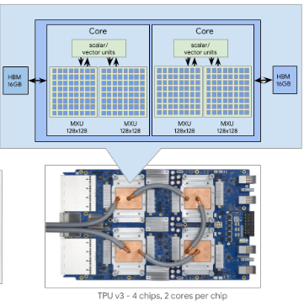
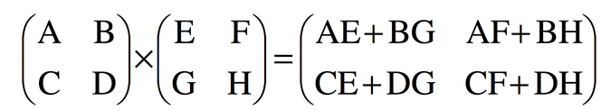
The math behind TPU
Parallel Processing: Matrix Multiplier Unit is designed as a matrix processor instead of scalar
Systolic Array: Architecture of the MXU
Full size is 128 x 128
Reuses inputs many times to produce the final output

Slide 20
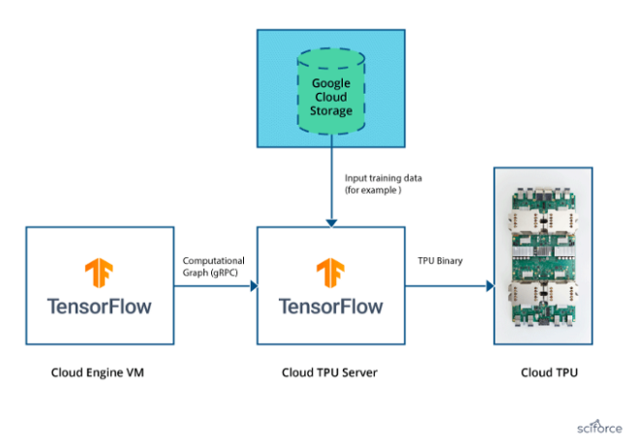
Shared technology by google for wider audience

Slide 21
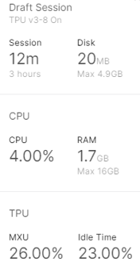
TPU monitor on kaggle
Performance monitor appears when TPU gauge clicked
The MXU percentage indicates how efficiently the TPU compute hardware is utilized → higher is better
The "Idle Time" percentage measures how often the TPU is sitting idle waiting for data
Optimizing data pipeline is needed to make this as low as possible
Measurements:
Refreshed approximately every 10 seconds
Only appear when the TPU is running a computation

Slide 22

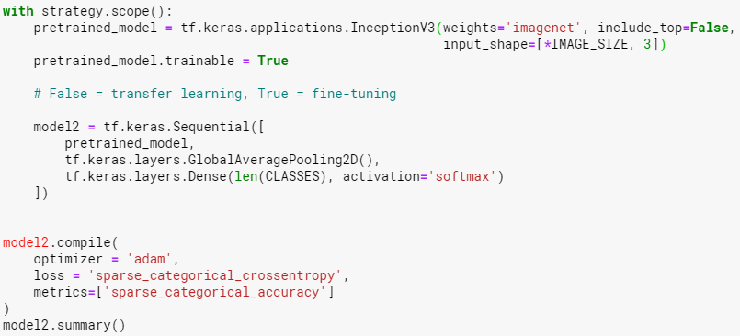
Inception_V3 On TPU (128 batches, 22 epochs)
Batch_Size = 16 * 8 = 128 batches

Slide 23
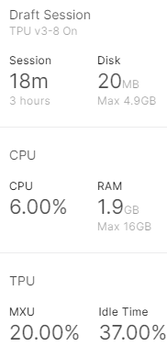
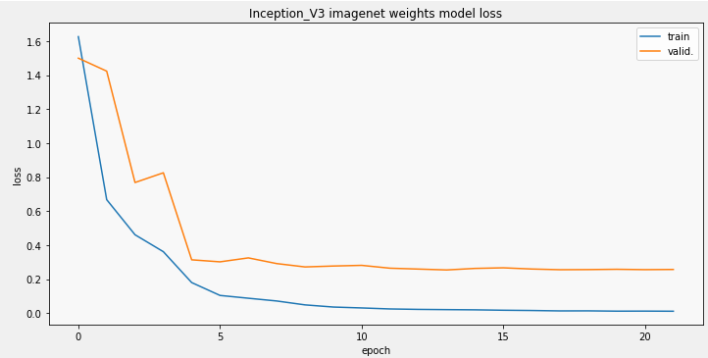
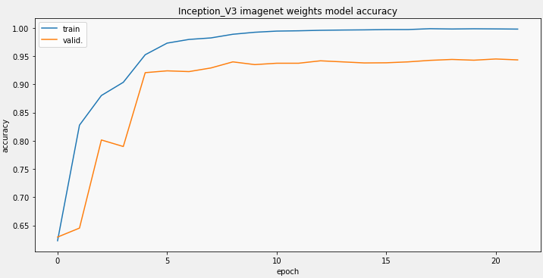
Inception_V3 On TPU (128 batches, 22 epochs)
Epoch 22/22 99/99 [==============================] - 28s 281ms/step - sparse_categorical_accuracy: 0.9998 - loss: 0.0029 - val_sparse_categorical_accuracy: 0.9421 - val_loss: 0.2601 - lr: 1.0000e-05

Slide 24
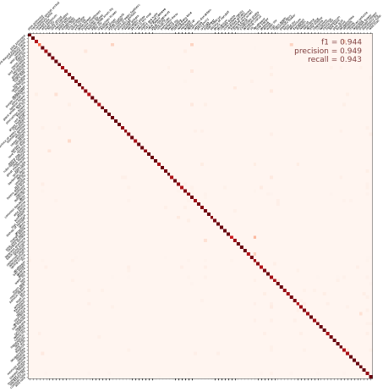
Inception_V3 On TPU (128 batches, 22 epochs)
Epoch 22/22 99/99 [==============================] - 28s 281ms/step - sparse_categorical_accuracy: 0.9998 - loss: 0.0029 - val_sparse_categorical_accuracy: 0.9421 - val_loss: 0.2601 - lr: 1.0000e-05

Slide 25
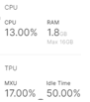

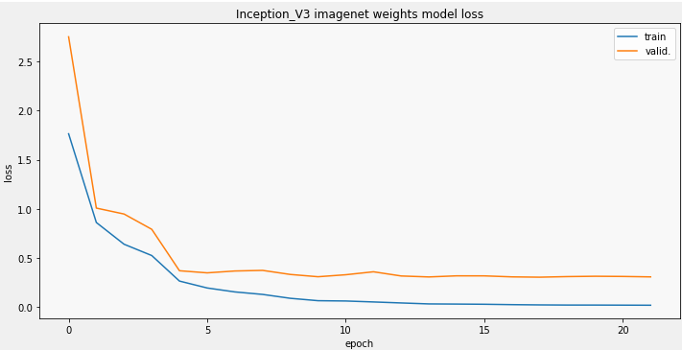
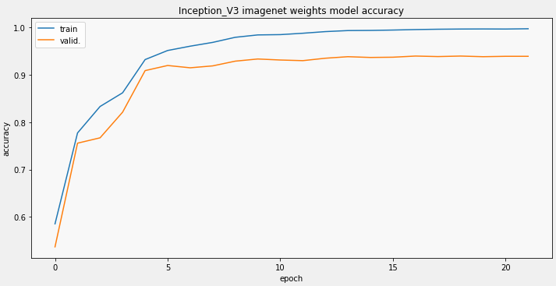
Decreasing batch_ size = 8 * 8 = 64 batches

Slide 26
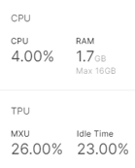

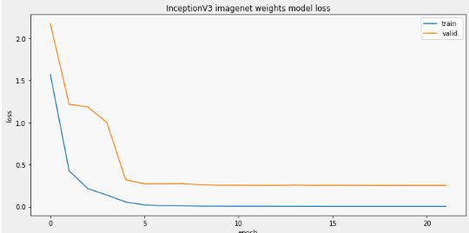
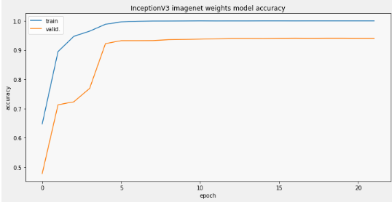
Increasing batch_ size = 32 * 8 = 256 batches
Notes:
The model itself is made up of symmetric and asymmetric building blocks, including convolutions, average pooling, max pooling, concats, dropouts, and fully connected layers.
Batchnorm is used extensively throughout the model and applied to activation inputs.
Loss is computed via Softmax.

Slide 27
comparison of inception_v3 model run with various batches per epoch
BATCH_SIZE | STEPS_PER_EPOCH | VAL_SPARSE_CATEGORICAL_ACCURACY | VAL_LOSS | F1 SCORE | MODEL RUN TIME
64 | 199 | 0.9391 | 0.3075 | 0.930 | 21 MINUTES
128 | 99 | 0.9434 | 0.2564 | 0.944 | 18 MINUTES
256 | 49 | 0.9405 | 0.2495 | 0.937 | 12 MINUTES
512 | 24 | 0.9367 | 0.2628 | 0.933 | 13 MINUTES
1028 | 12 | 0.9321 | 0.2757 | 0.927 | 69 MINUTES

Slide 28
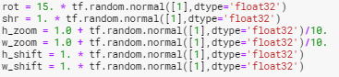

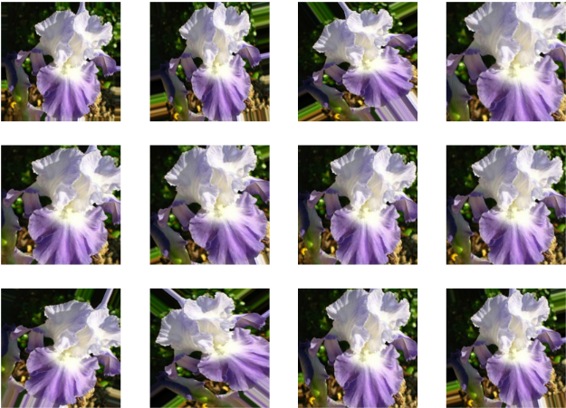
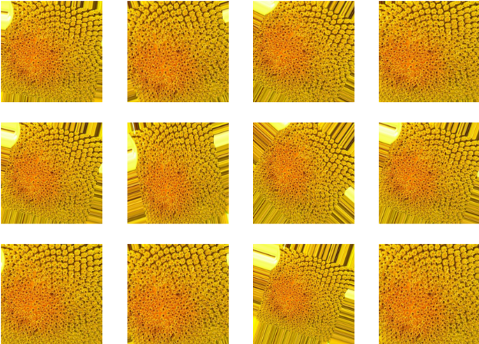
Image Augmentation (Transformation - rotation)

Slide 29
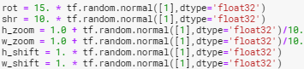
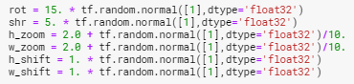
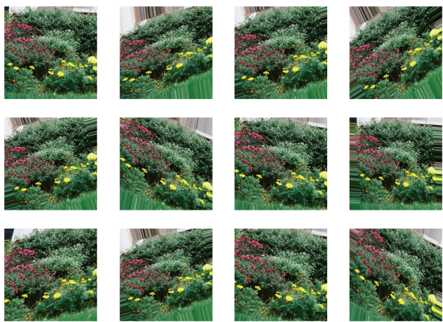
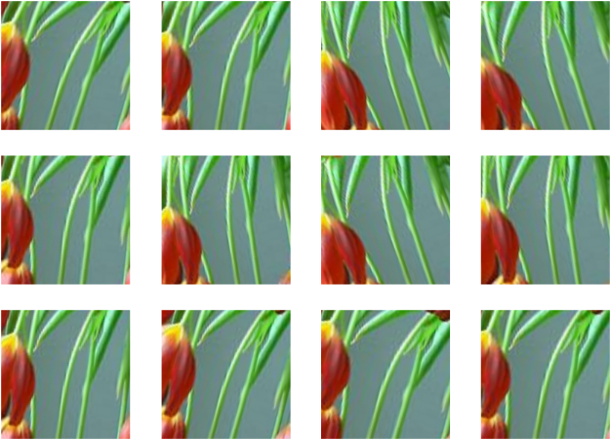
Image Augmentation (Transformation – rotation + shrink+ zooM)

Slide 30
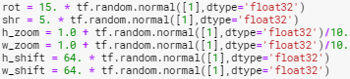
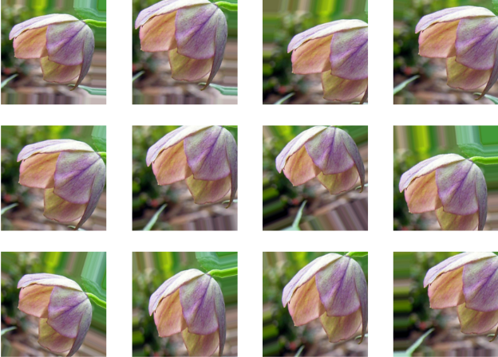
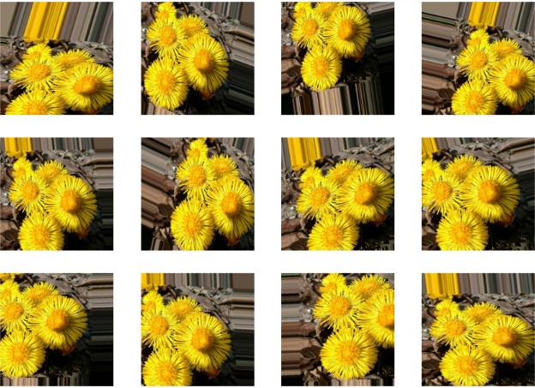
Image Augmentation (Transformation – rotation + shrink + zoom + shift)

Slide 31




Image Augmentation (Transformation – rotation + shrink +zoom + shift) for model

Slide 32



Image Augmentation (Transformation – rotation + shrink + zoom+ shift +saturation)

Slide 33


Image Augmentation (Transformation – rotation + shrink + zoom+ shift + saturation)

Slide 34



Inception_V3, batches 128, Epochs 22, Augmented

Slide 35
comparison of inception_v3 model run with VERSUS WITHOUT AUGMENATION
AUGMENTED | STEPS_PER_EPOCH | VAL_SPARSE_CATEGORICAL_ACCURACY | VAL_LOSS | F1 SCORE | MODEL RUN TIME
YES | 99 | 0.9442 | 0.2642 | 0.936 | 16 MINUTES
NO | 99 | 0.9434 | 0.2564 | 0.944 | 18 MINUTES

Slide 36

Inception_V3 MODEL TRAINABLE PARAMETER COMPARISONS
FINE TUNING
TRANSFER LEARNING
Pretrained_model.trainable = True
Adjusts the weights and biases of the pre-trained model → initial values adjusted in training
Works well on big data
Pretrained_model.trainable = False
Freezes the weights and biases of the pre-trained model → only trains softmax layer
Works well on small data

Slide 37



Inception_V3 WITH AUGMENTED DATA WITH Transfer learning AT 22 EPOCHS

Slide 38



Inception_V3 WITH AUGMENTED DATA WITH Transfer learning AT 100 EPOCHS

Slide 39
comparison of inception_v3 model run with VERSUS WITHOUT TRANSFER LEARNING
TRANSFER LEARNING | NUMBER OF EPOCHS | VAL_SPARSE_CATEGORICAL_ACCURACY | VAL_LOSS | F1 SCORE
NO | 22 | 0.9442 | 0.2642 | 0.936
YES | 22 | 0.6775 | 1.4767 | 0.560
YES | 100 | 0.8314 | 0.6653 | 0.820

Slide 40


Inception_V3 WITH AUGMENTED DATA WITH FINE TUNING (ORIGINAL) AT 100 EPOCHS

Slide 41
comparison of inception_v3 model run with FINE Tuning at 22 Versus 100 epochs
NUMBER OF EPOCHS | VAL_SPARSE_CATEGORICAL_ACCURACY | VAL_LOSS | F1 SCORE | MODEL RUN TIME
22 | 0.9442 | 0.2642 | 0.936 | 16 MINUTES
100 | 0.9432 | 0.2796 | 0.939 | 64 MINUTES

Slide 42


DenseNet201

Slide 43


DenseNet201

Slide 44



EFFICIENTNETB7

Slide 45


EFFICIENTNETB7

Slide 46

Efficiency comparison on tpu

Slide 47
COST EFFECTIVE comparison of models
MODEL NAME | LAYERS | VAL_SPARSE_CATEGORICAL_ACCURACY | VAL_LOSS | F1 SCORE | TRAINABLE PARAMETERS | MODEL RUN TIME
INCEPTION_V3 | 159 | 0.9442 | 0.2642 | 0.936 | 21,981,448 | 16 MINUTES
DENSENET201 | 201 | 0.9518 | 0.2249 | 0.952 | 18,292,712 | 29 MINUTES
EFFICIENTNETB7 | 813 | 0.9596 | 0.2119 | 0.957 | 64,053,304 | 51 MINUTES

Slide 48
TPU Limitations & challenges
Google charges $4.50 per hour(s)
Kaggle allows up to 30 hours per week of TPU use and 3 hours per session
Difficulty in setting up buckets for data set up on Google Cloud
Unnecessary for models which are not deep learning, but crashes if large amount of data or memory is needed if not on TPU.

Slide 49


Best Cost – Effective Model Inception_V3 Prediction

Slide 50

Best Cost – Effective Model Inception_V3 Prediction

Slide 51
Future Exploration & appreciation of support
Future Exploration
Fine Tune the Inception_V3 model parameters
Compete actively in Kaggle competitions to increase confidence and grow collaboration ability
Improve the Google Cloud skills necessary to be able to effectively run models on TPU
Appreciation of Support
Dr. Mhoon – Knowledge and kindness exemplified
Ms. Griffin – Always constant and quick support
Dr. Shastri and Dr. Soibam – Challenging yet supportive
Dr. King and Dr. Nguyen – Thoroughly explained mathematical concepts
Learn PyTorch using XLA to improve modeling efficiency and accuracy

Slide 52
resources
Asifullah Khan, Anabia Sohail, Umme Zahoora , and Aqsa Saeed Qureshi; A Survey of the Recent Architectures of Deep Convolutional Neural Networks. Published in Artificial Intelligence Review, DOI: https://doi.org/10.1007/s10462-020-09825-6 1 arXiv:1901.06032 [cs.CV]
Mahbub Hussain, Jordan J. Bird, Diego R. Faria; A Study on CNN Transfer Learning for Image Classification. Part of the Advances in Intelligent Systems and Computingbook series (AISC, volume 840). Published on 11 August 2018
Yang You, Zhao Zhang, Cho-Jui Hsieh, James Demmel, Kurt Keutzer; Computer Vision and Pattern Recognition (cs.CV). Published online 14 Sep 2017

Slide 53
resources
Codementor:
https://www.codementor.io/@sheena/python-path-virtualenv-import-for-beginners-du107r3o1
GitHub:
https://github.com/tensorflow/tensorflow/releases/tag/v2.2.0-rc4
Google Cloud Learning Resources:
https://cloud.google.com/tpu/docs/inception-v3-advanced
https://cloud.google.com/tpu/docs/tpus
https://codelabs.developers.google.com/codelabs/keras-flowers-tpu/#5
https://cloud.google.com/tpu/docs/more-models

Slide 54
resources
Kaggle:
Learn With Me: Getting Started with Tensor Processing Units (TPUs) | Kaggle: https://www.youtube.com/watch?v=1pdwRQ1DQfY&feature=youtu.be
https://www.kaggle.com/docs/tpu
Medium:
https://medium.com/sciforce/understanding-tensor-processing-units-10ff41f50e78
https://medium.com/@antonpaquin/whats-inside-a-tpu-c013eb51973e
Tensorflow:
https://www.tensorflow.org/guide/keras/transfer_learning

